Slide 1

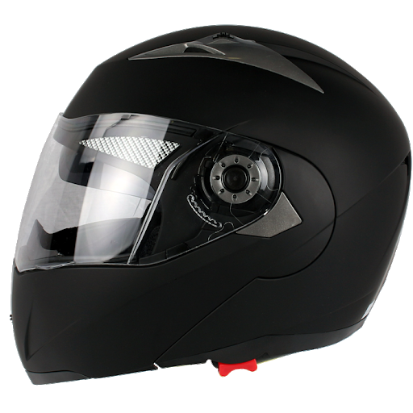

Smart helmet
Team members:
Mrinal Satyawanshi (205119057)
Sunil Solanki (205119103)
Vipin Kumar Niranjan (205118085)
Kunal Bhavsar (205118030)
Vaibhav Vikas (205118081)
Mayank Sharma(205119053)

Slide 2
Introduction:
Smart Helmet is smart device which will be used to send SOS messages in case of bike accidents.
It will take readings of the impact on the helmet at the time of accident.
Will trigger an sms to emergency contacts and nearby hospitals.

Slide 3
Why SMART HELMET?
Helmet, as a protective gear to prevent fatal injuries while riding two-wheelers, needs to be evaluated by quality data.
Accidents in Remote industrial areas and deserted roads are very common.
Even a victim who can be saved does not get help at appropriate time.
Use of smart helmet will lead to reduce death rate as well as increase the awareness for safety measures.

Slide 4
Statistics about bike accidents:
4 people die every hour in India because they do not wear a helmet.
The highest death toll was in Tamil Nadu. A total of 6,105 (around 17 per cent) two-wheeler users who died here in road accidents did not wear a helmet.
Around 23.8% people can’t be saved even after they wear a helmet due to lack of emergency treatment at the accident spot.

Slide 5
Objectives:
To detect the impact and the force at the time of accident.
To decrease the deaths caused even after wearing a helmet.
To trigger an emergency message to hospital and emergency contacts.
To increase the awareness of wearing helmets.

Slide 6
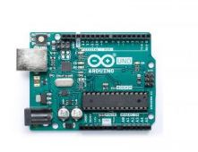
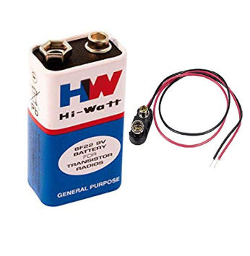
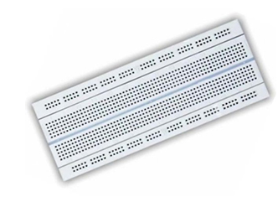
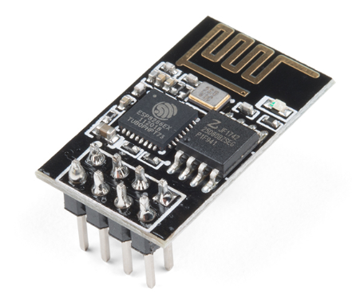
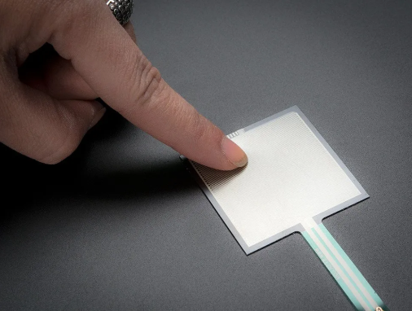
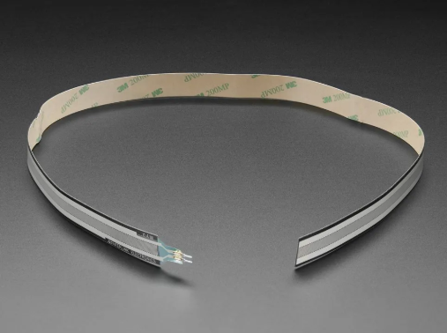
Components:
Arduino Uno
Batteries 9V
Breadboard
ESP8266 wifi module
Force sensitive resistor
Elongated FSR Band

Slide 7
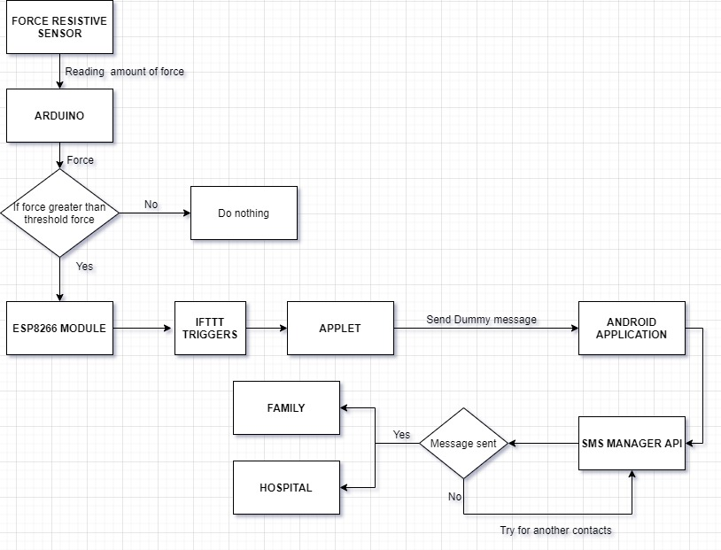
Block Diagram:

Slide 8
Innovativeness:
The idea to use the helmet for saving lives.
Tie up with hospitals for direct emergency medical help at the spot of accident.
No need for extra human effort.

Slide 9
Future Scope:
Integration of Heartbeat sensor into the module for better accuracy.
Custom integrated circuit chip for the whole mechanism.
Using Picamera to send the video clip of the accident.

Slide 10
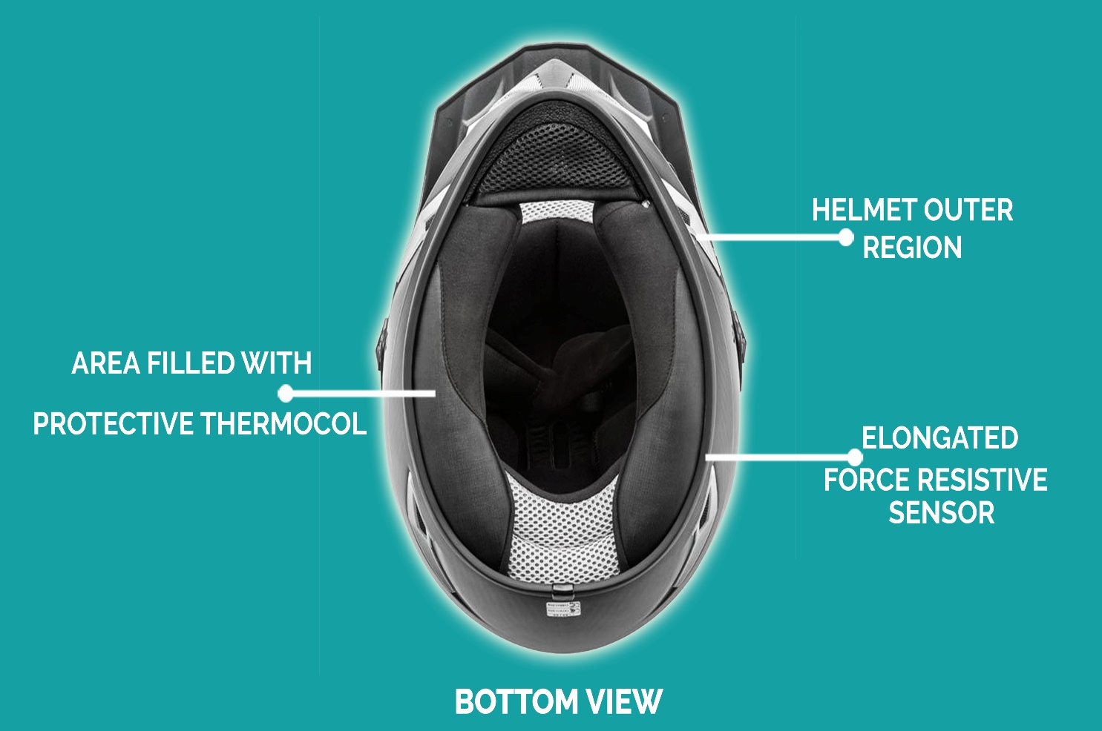
Proposed Design

Slide 11
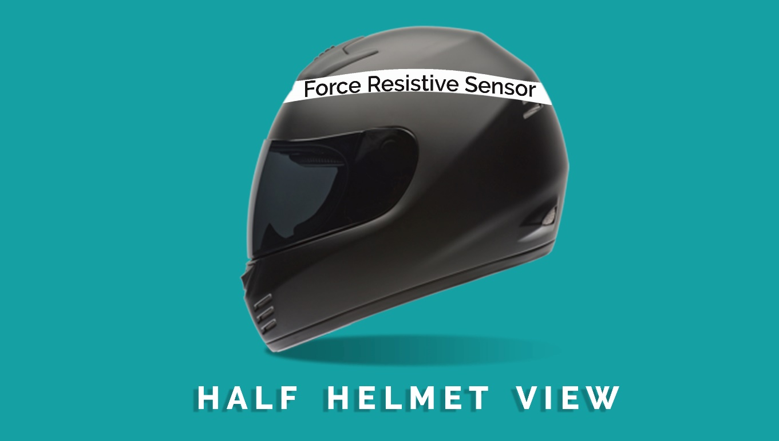
Proposed Design

Slide 12
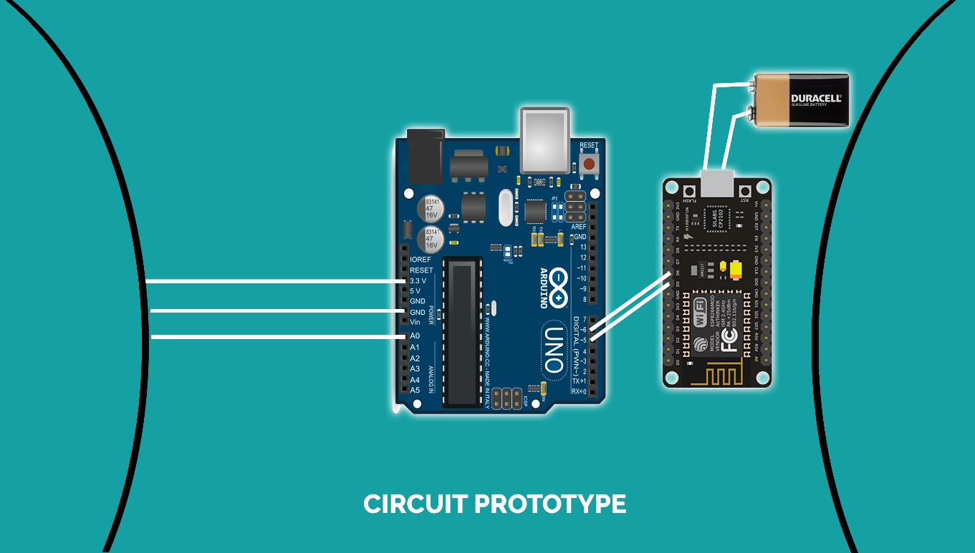
Proposed Design:

Slide 13
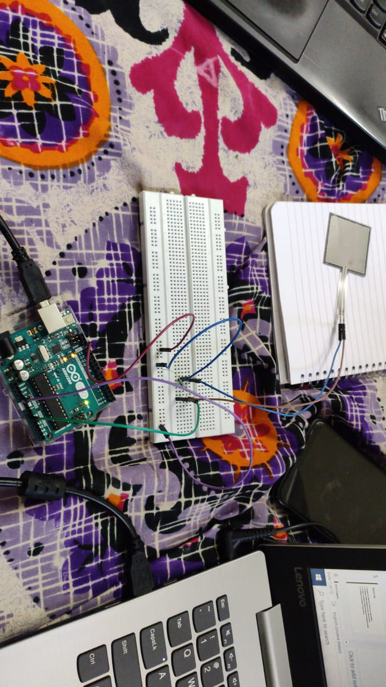
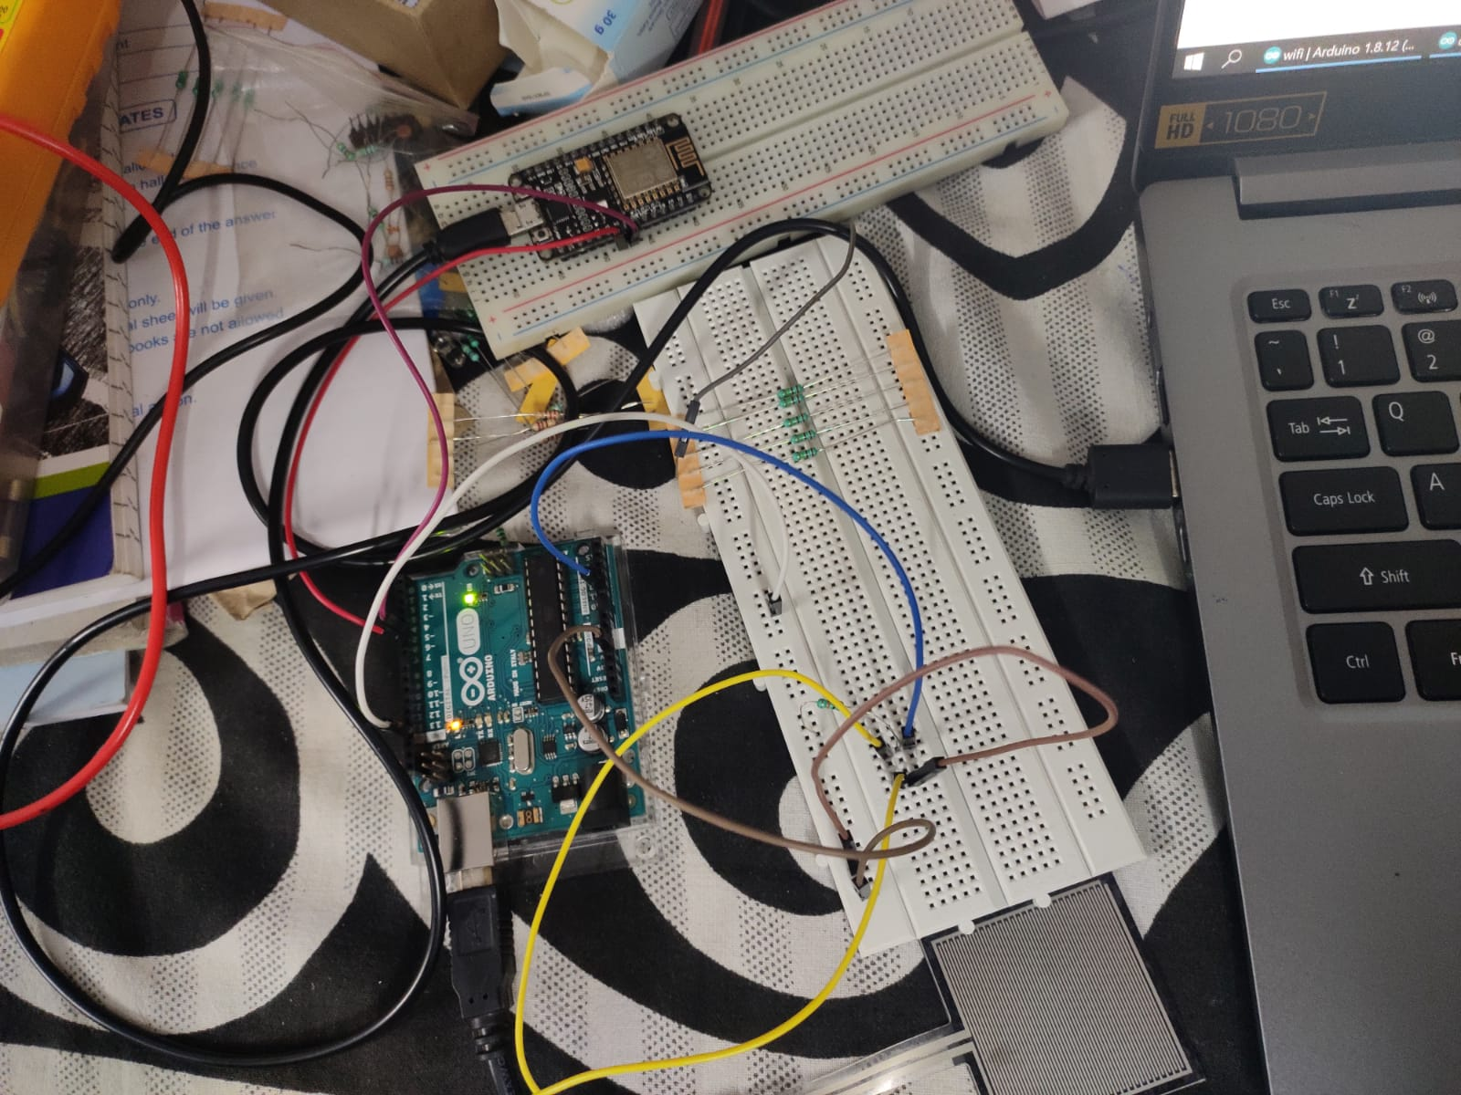
Progress of Project:

Slide 14
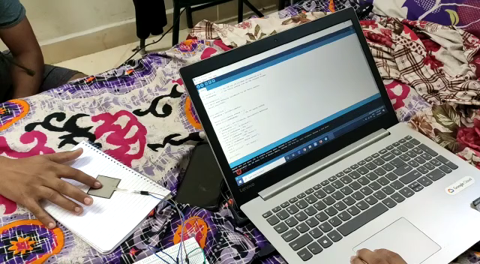
Progress of Project

Slide 15
References:
https://www.ncbi.nlm.nih.gov/pmc/articles/PMC6182975/
https://www.indiatoday.in/diu/story/two-wheeler-death-road-accidents-helmets-states-india-1602794-2019-09-24
https://www.electronicwings.com/sensors-modules/esp8266-wifi-module
https://www.elprocus.com/force-sensing-resistor-technology/

Slide 16
PREVENTION IS BETTER THAN CURE ☺ THANK YOU

